Slide 1
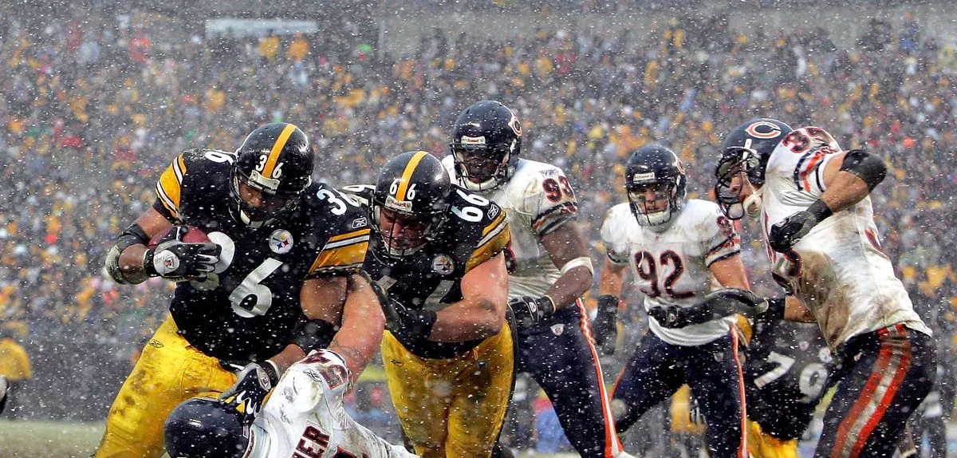




WEATHER TO BE IN OR OUT.
NFL team performance base on geography and stadium type
Data Analytics Project- Groupe 0: Alimam, Subhra, Mike & Carlos

Slide 2
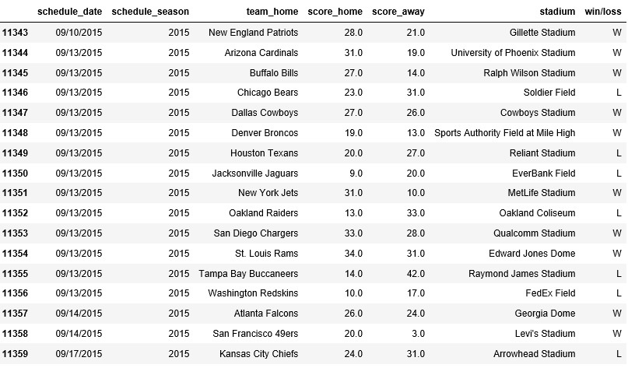
Stadium Types
Introduction
2015-2016 Seasons
Open air
Retractable
Dome
Geography

Slide 3
Hypothesis
NFL teams with Domes or Closable roofs should have better records since they don't have to play home games in bad weather.
Null
Null: Having a Dome or Closable roof does not affect an NFL team's record.

Slide 4

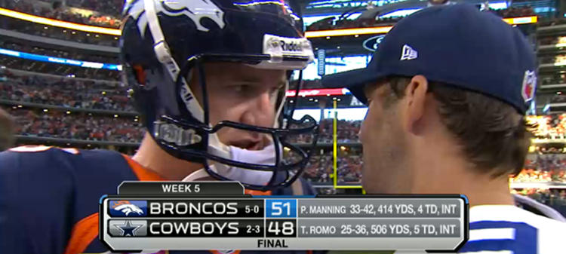

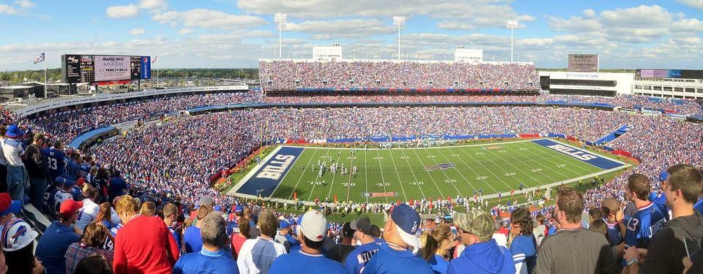
Data exploration and Cleaning up
Json
CSV
Weather API
Data Exploration
Nfl_data.csv
weather_data.csv
stadiums_merge_type.csv
Spreadspoke_Scores_W_key.csv
Cleaning UP
NFL Scores Data
Source
National Football League (NFL) Stadiums in the United States
Source
NFL API Documentation
Source
World weather
Weather
Stadium

Slide 5
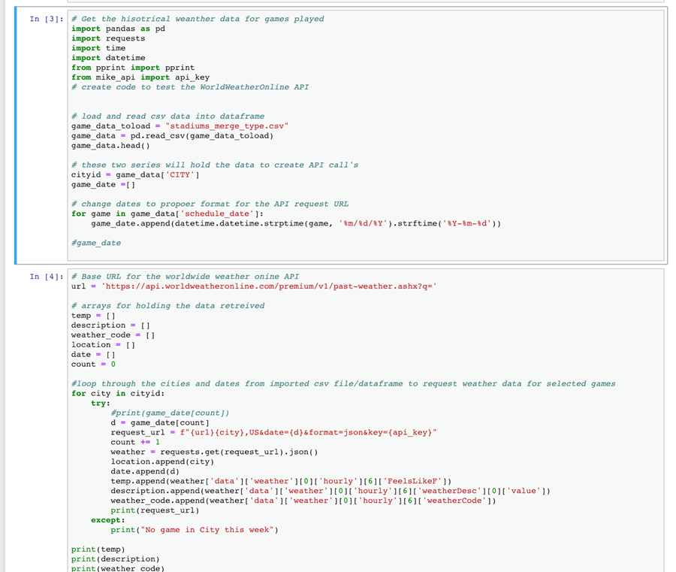
Major Findings
We found the roof types of the stadium, results of home games, and weather of games dates.

Slide 6
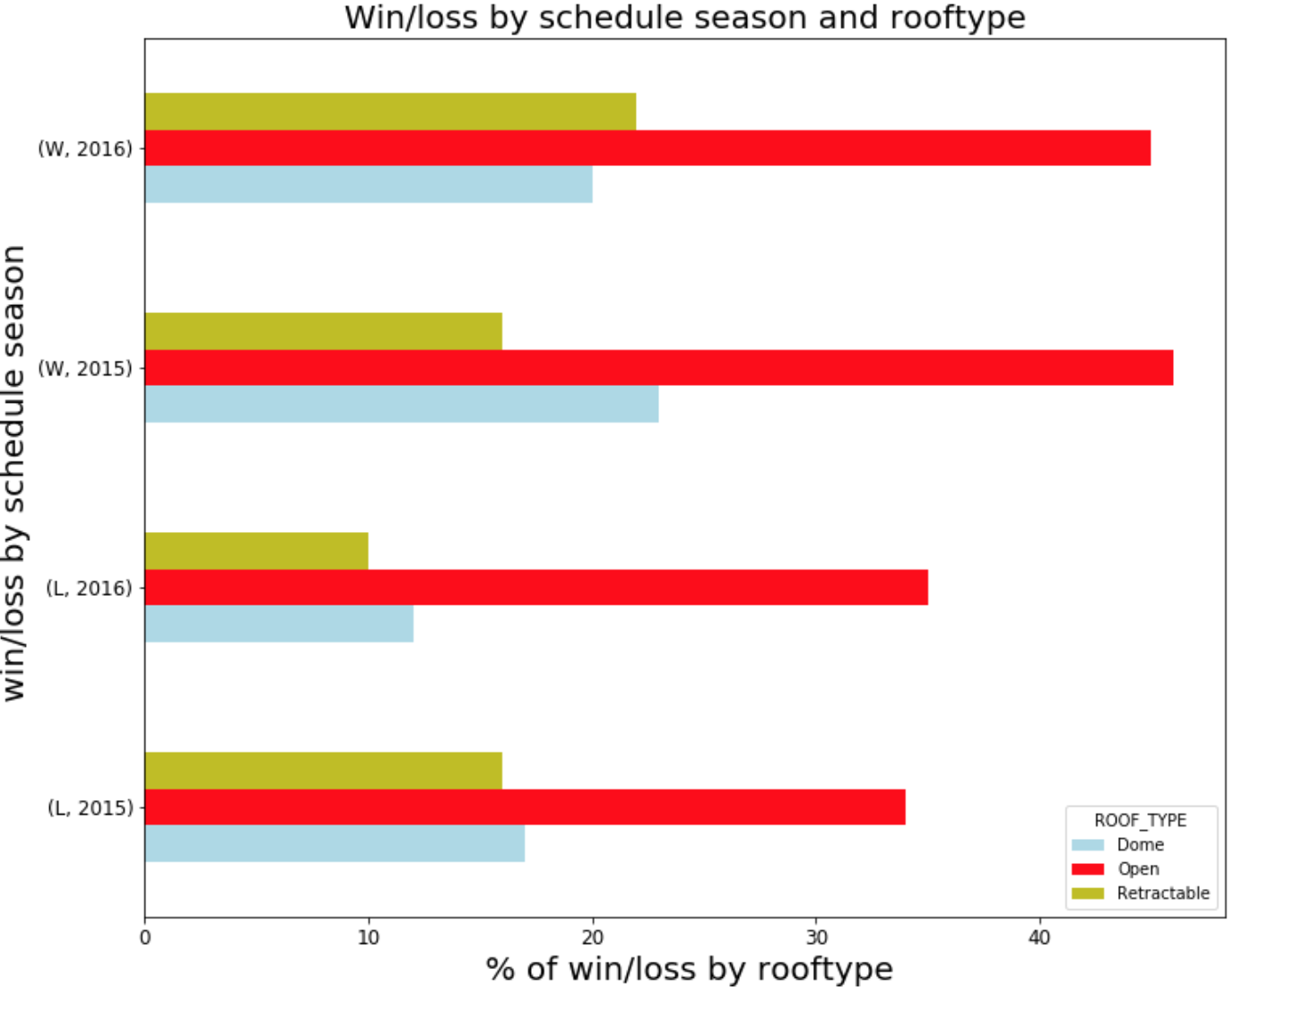
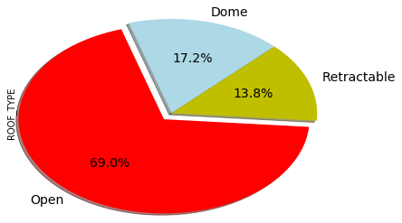
Lets Visualize Data with Matplotlib
Research Question 1 : Win or Loss affected by roof Type
The graph below depicts the win/ loss percentage by roof types
The graph below depicts the percentage by roof types

Slide 7
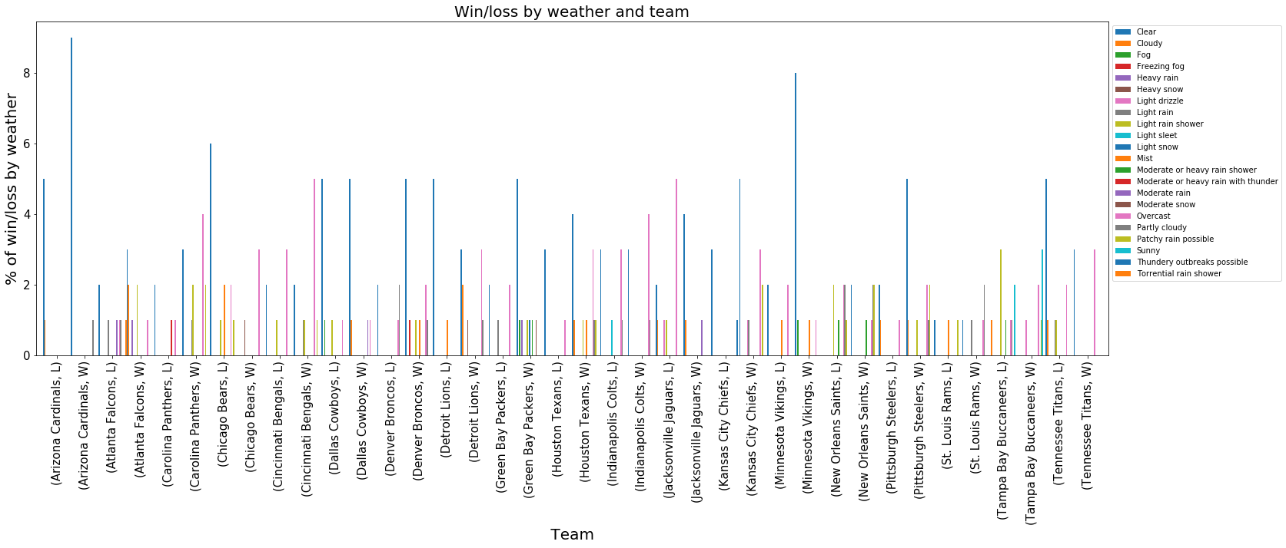
Lets Visualize Data with Matplotlib
Research Question 2: Win or loss affected by weather and team?

Slide 8
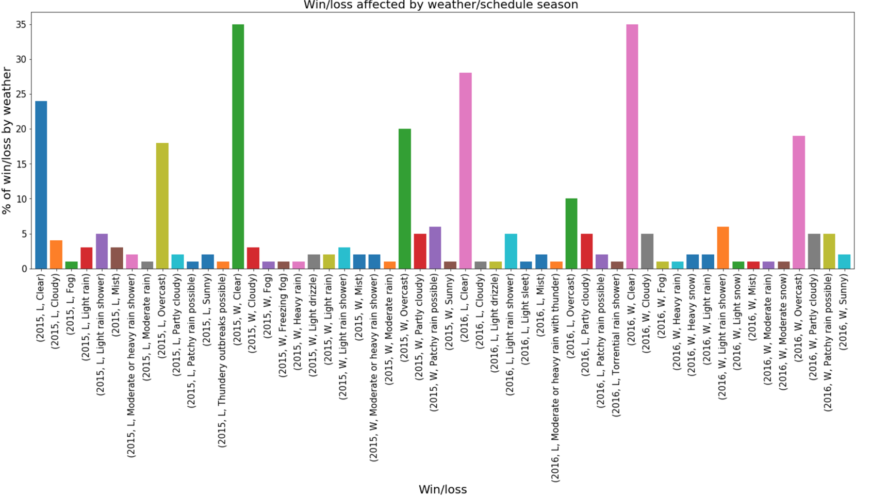
Lets Visualize Data with Matplotlib
Research question 3: How weather type and roof type can affect game performance?

Slide 9
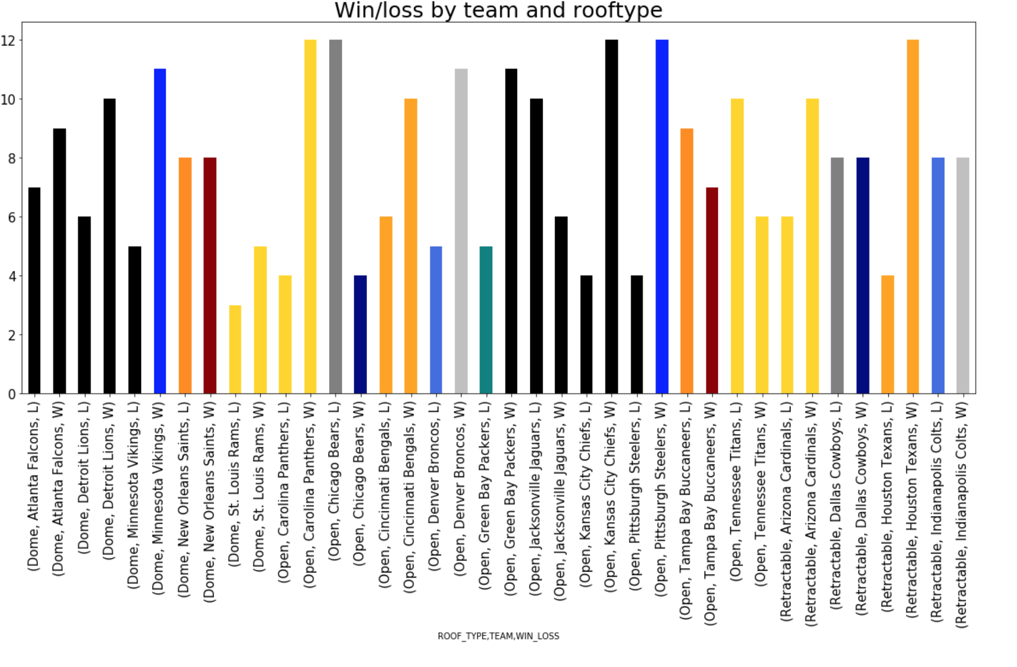

Slide 10
Conclusion
Due to the limits od allowable API request, We recognize that our sample size is not enough to make an accurate conclusion.
However It is clear that weather doesn’t in fact affect the outcome of a football game.

Slide 11
References
National Football League (NFL) Stadiums in the United States https://public.opendatasoft.com/explore/dataset/stadiums_nfl/export/
NFL API Documentation http://www.suredbits.com/api/#NFLData
Historical Weather API https://www.worldweatheronline.com/developer/api/docs/historical-weather-api.aspx

Slide 12
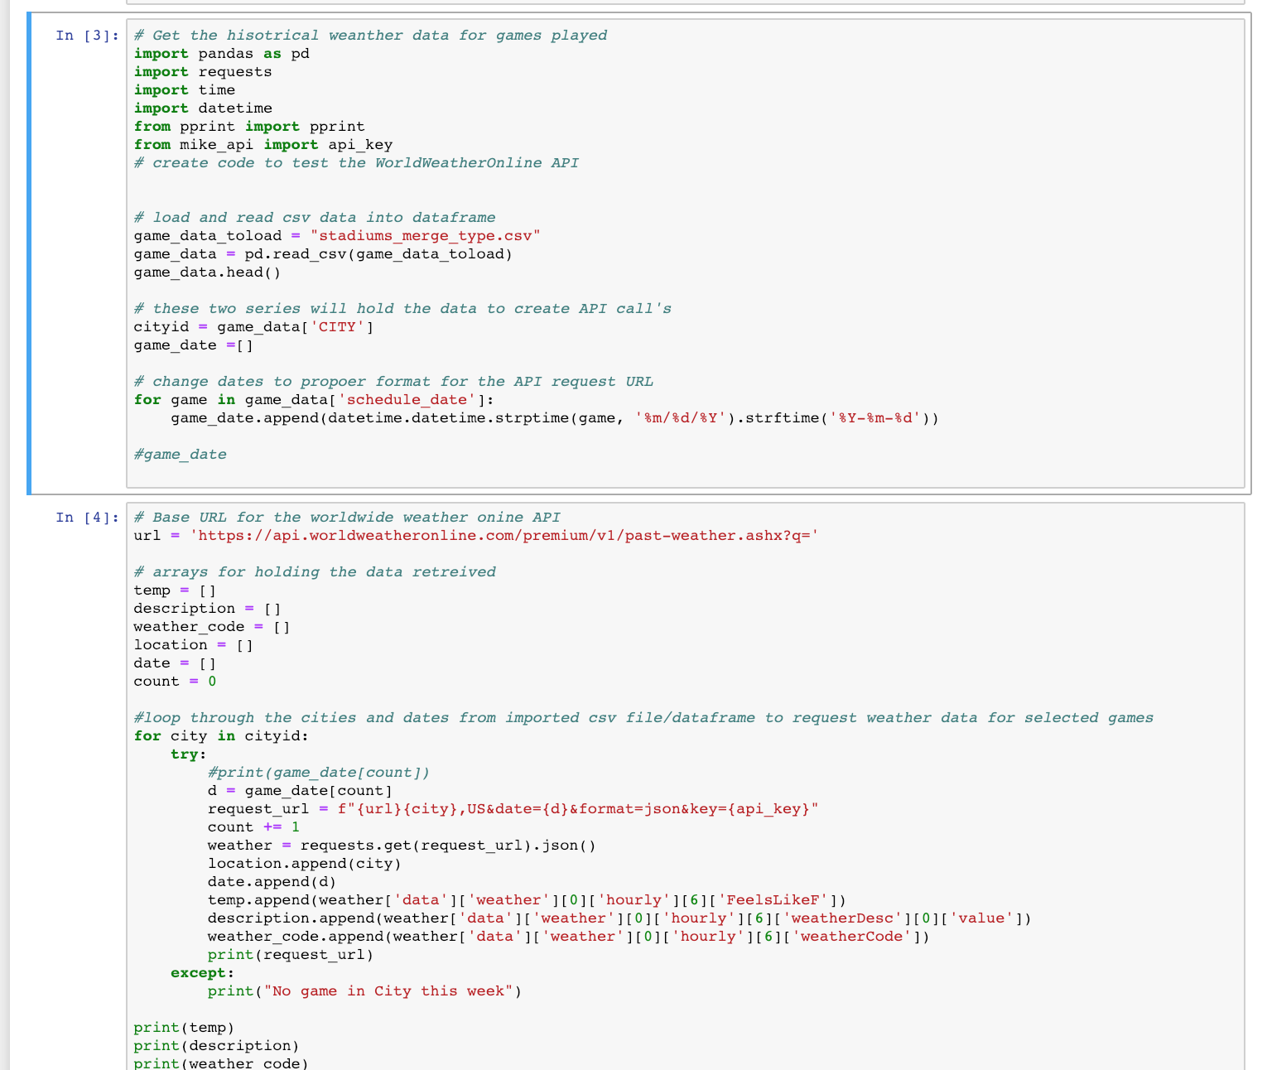
Snippet codes samples

Slide 13
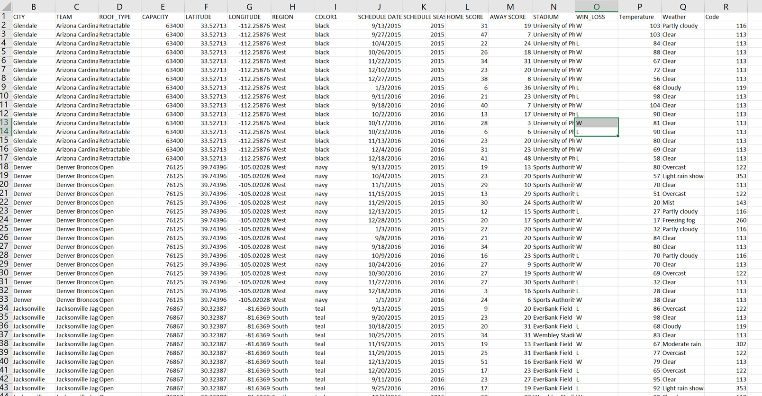
Final dataframe sample

